Slide 1



"Breath of Clarity: Advancing Pneumonia Detection through Innovative Technology"
Team members: Mayurkumar M Patel
tirth g shah

Slide 2
Introduction
The project mainly enables us to implement some of the well-known models like VGG19, RESNET 152,200 as well as asks us to explore on how to build CNN models as well as how to adjust the hyper parameters to get more accuracy.
This project was a dive into the current as well as past works of AI and ML that are being developed to detect Pneumonia.
Such models can improve the speed and efficacy of doctors' diagnosis, boosting prompt treatment and possibly saving lives as AI technology becomes more mobile-friendly.

Slide 3
Motivation
Pneumonia, a leading cause of morbidity and mortality worldwide, requires timely diagnosis and treatment to improve patient outcomes.
Current diagnostic methods, such as chest X-rays and clinical symptoms, can be inconclusive, slow, and resource-intensive.
There is an urgent need to develop a fast, accurate, and accessible pneumonia detection system that can be easily implemented in diverse healthcare settings, reducing the burden on healthcare professionals and improving patient care.

Slide 4
Approach
Try and test pre-trained models like ResNet 152, 200 and VGG19
Create CNN model and compare it with pre-trained models based on accuracy.
Use dataset to train and test the model.
Use evaluation metrics to evaluate and achieve highest accuracy.

Slide 5
Software Tools to be used:
Python 3.8
Libraries:
Tensorflow
Pytorch
Keras
Sci-Kit Learn
Matplotlib
Numpy
TQDM

Slide 6
Dataset
In this project, we will be using the Chest X-Ray Images (Pneumonia) Dataset.
We used the “Labeled Optical Coherence Tomography (OCT) and Chest X-Ray Images for Classification” created by University of California San Diego.
The dataset consists of 5863 images that are each classified that accurately describe the image.

Slide 7
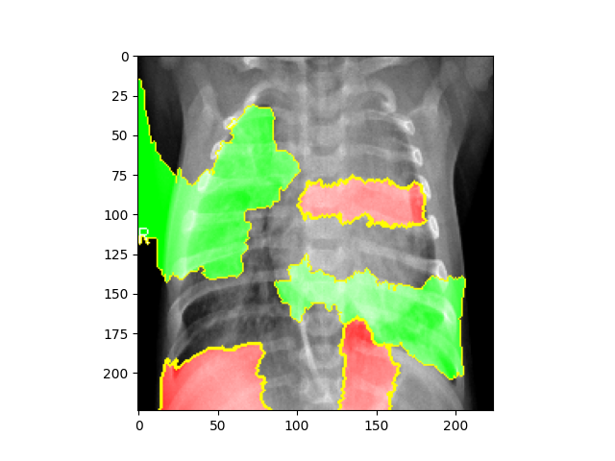
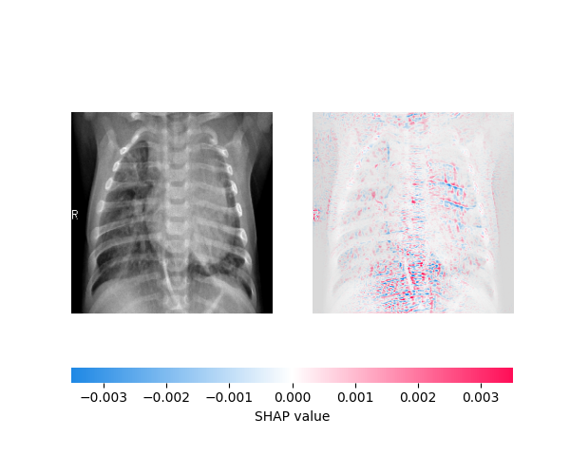
VGG 19
We used VGG19 to first check for accuracy as it is a well-suited model for this project due to its proven success in image recognition tasks.
It’s ability to capture complex patterns in images, and its transfer learning potential, allowing for efficient training and high accuracy in pneumonia detection from lung images.
We were able to achieve 92% Accuracy with this model.

Slide 8
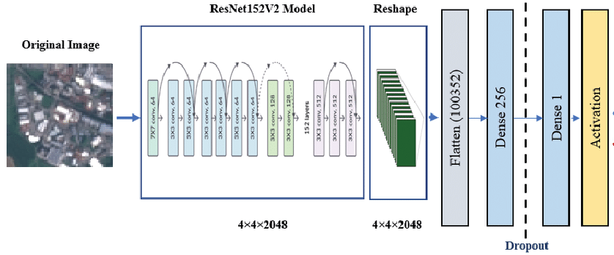
RESNET 152 & 200
We chose ResNet-152 and custom ResNet-200 for this project allows us to leverage the strengths of deep residual networks in feature extraction and pattern recognition.
These architectures have demonstrated exceptional performance in image classification tasks, and their increased depth can potentially enhance the model's accuracy in detecting pneumonia, while also providing the opportunity to compare and assess the performance of different network depths in this specific application.
Due to hardware constraints and the complexity of the models, we were only able to achieve 87.18% and 83% accuracy, respectively.

Slide 9
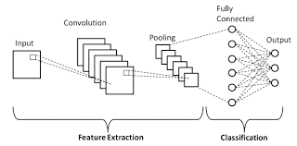
Convolutional Neural Network
CNNs excel at analyzing visual data and automatically learning complex features within images.
Hence it was an ideal choice for accurately and efficiently detecting pneumonia patterns in lung images, which can significantly improve diagnostic processes.
So, we tried creating one of our own Convolutional Neural Network. As of now, we are still trying to improvise as we are only able to get 60% accuracy.

Slide 10
Evaluation Metrics
Accuracy
Precision
Recall (Sensitivity)
F1-score
Confusion Matrix

Slide 11
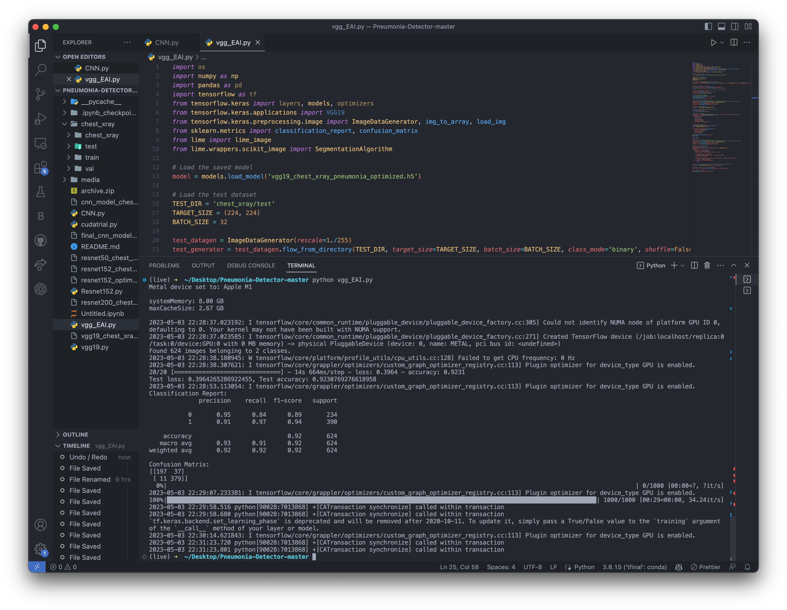
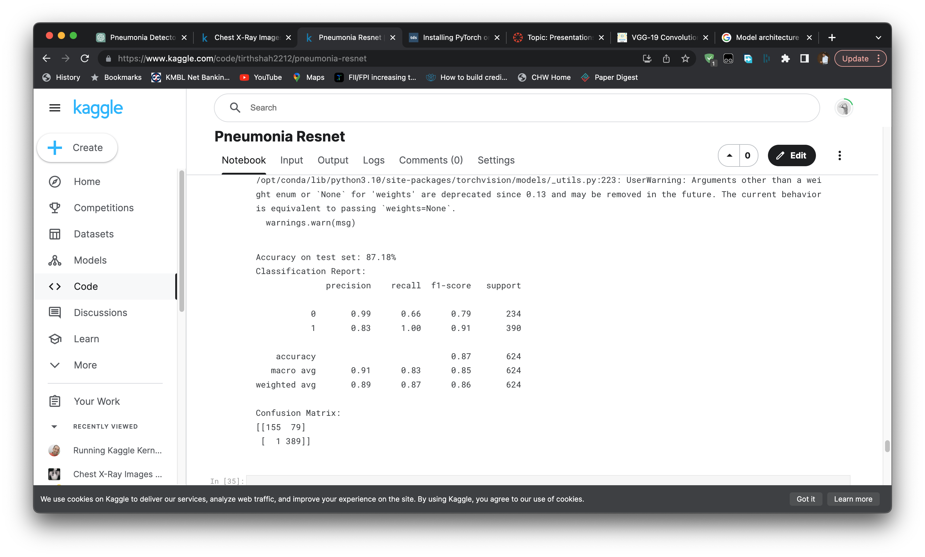
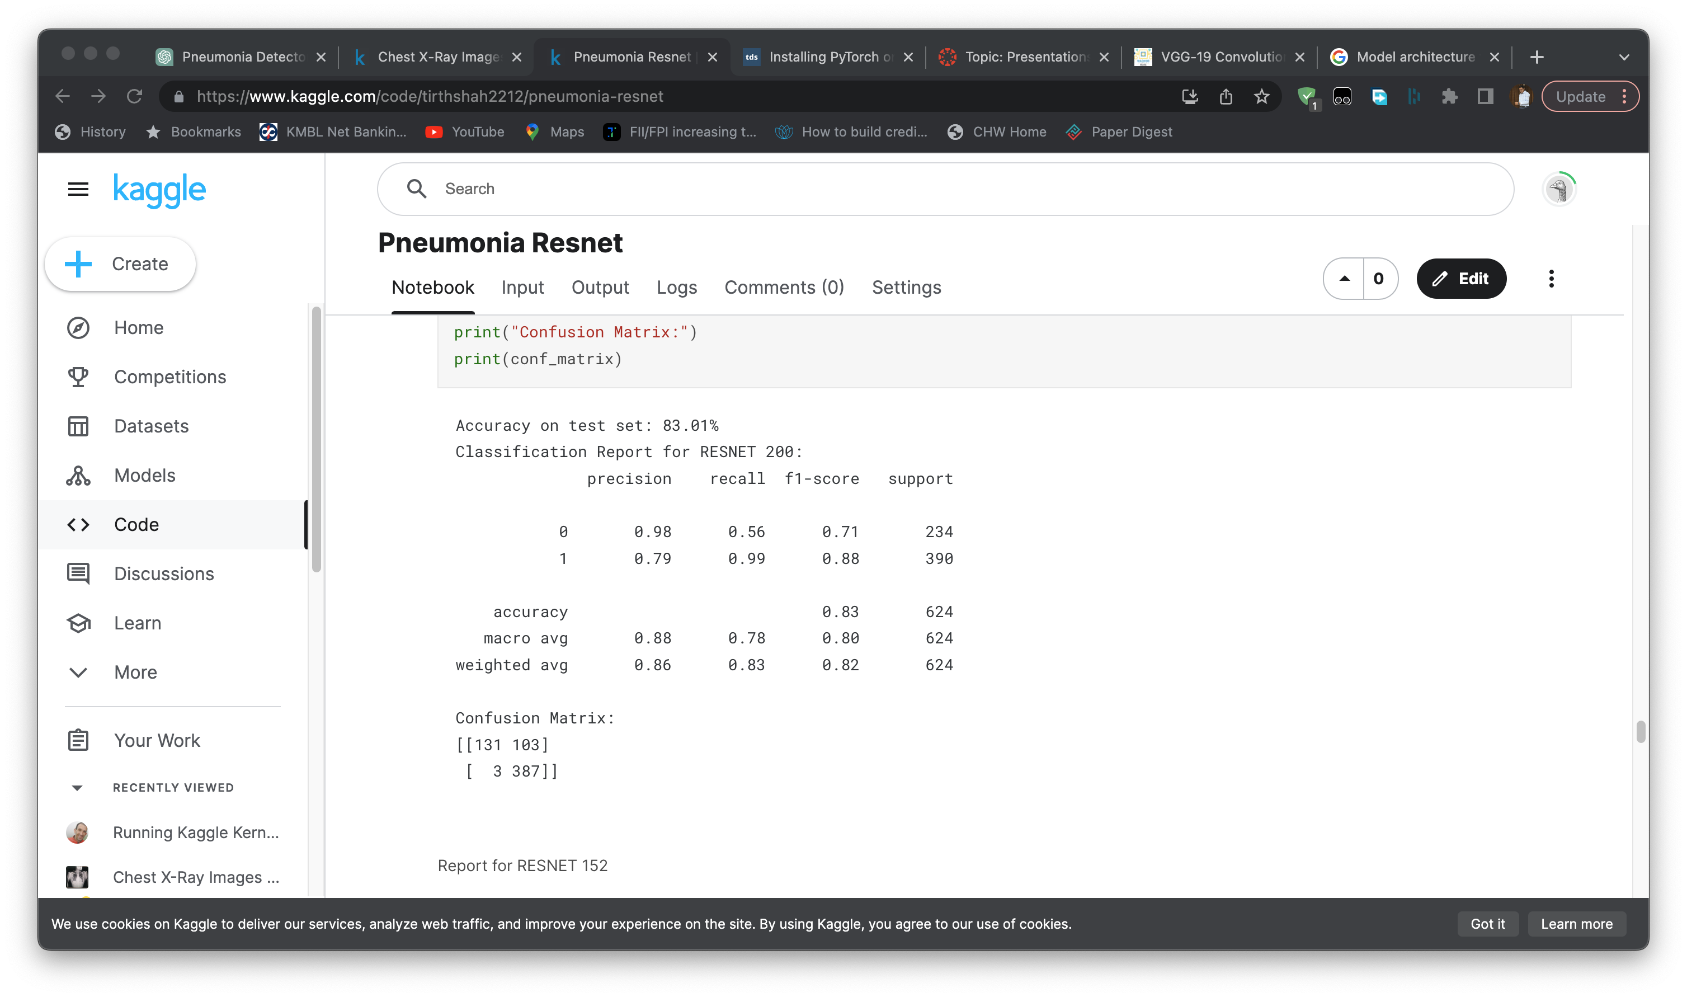
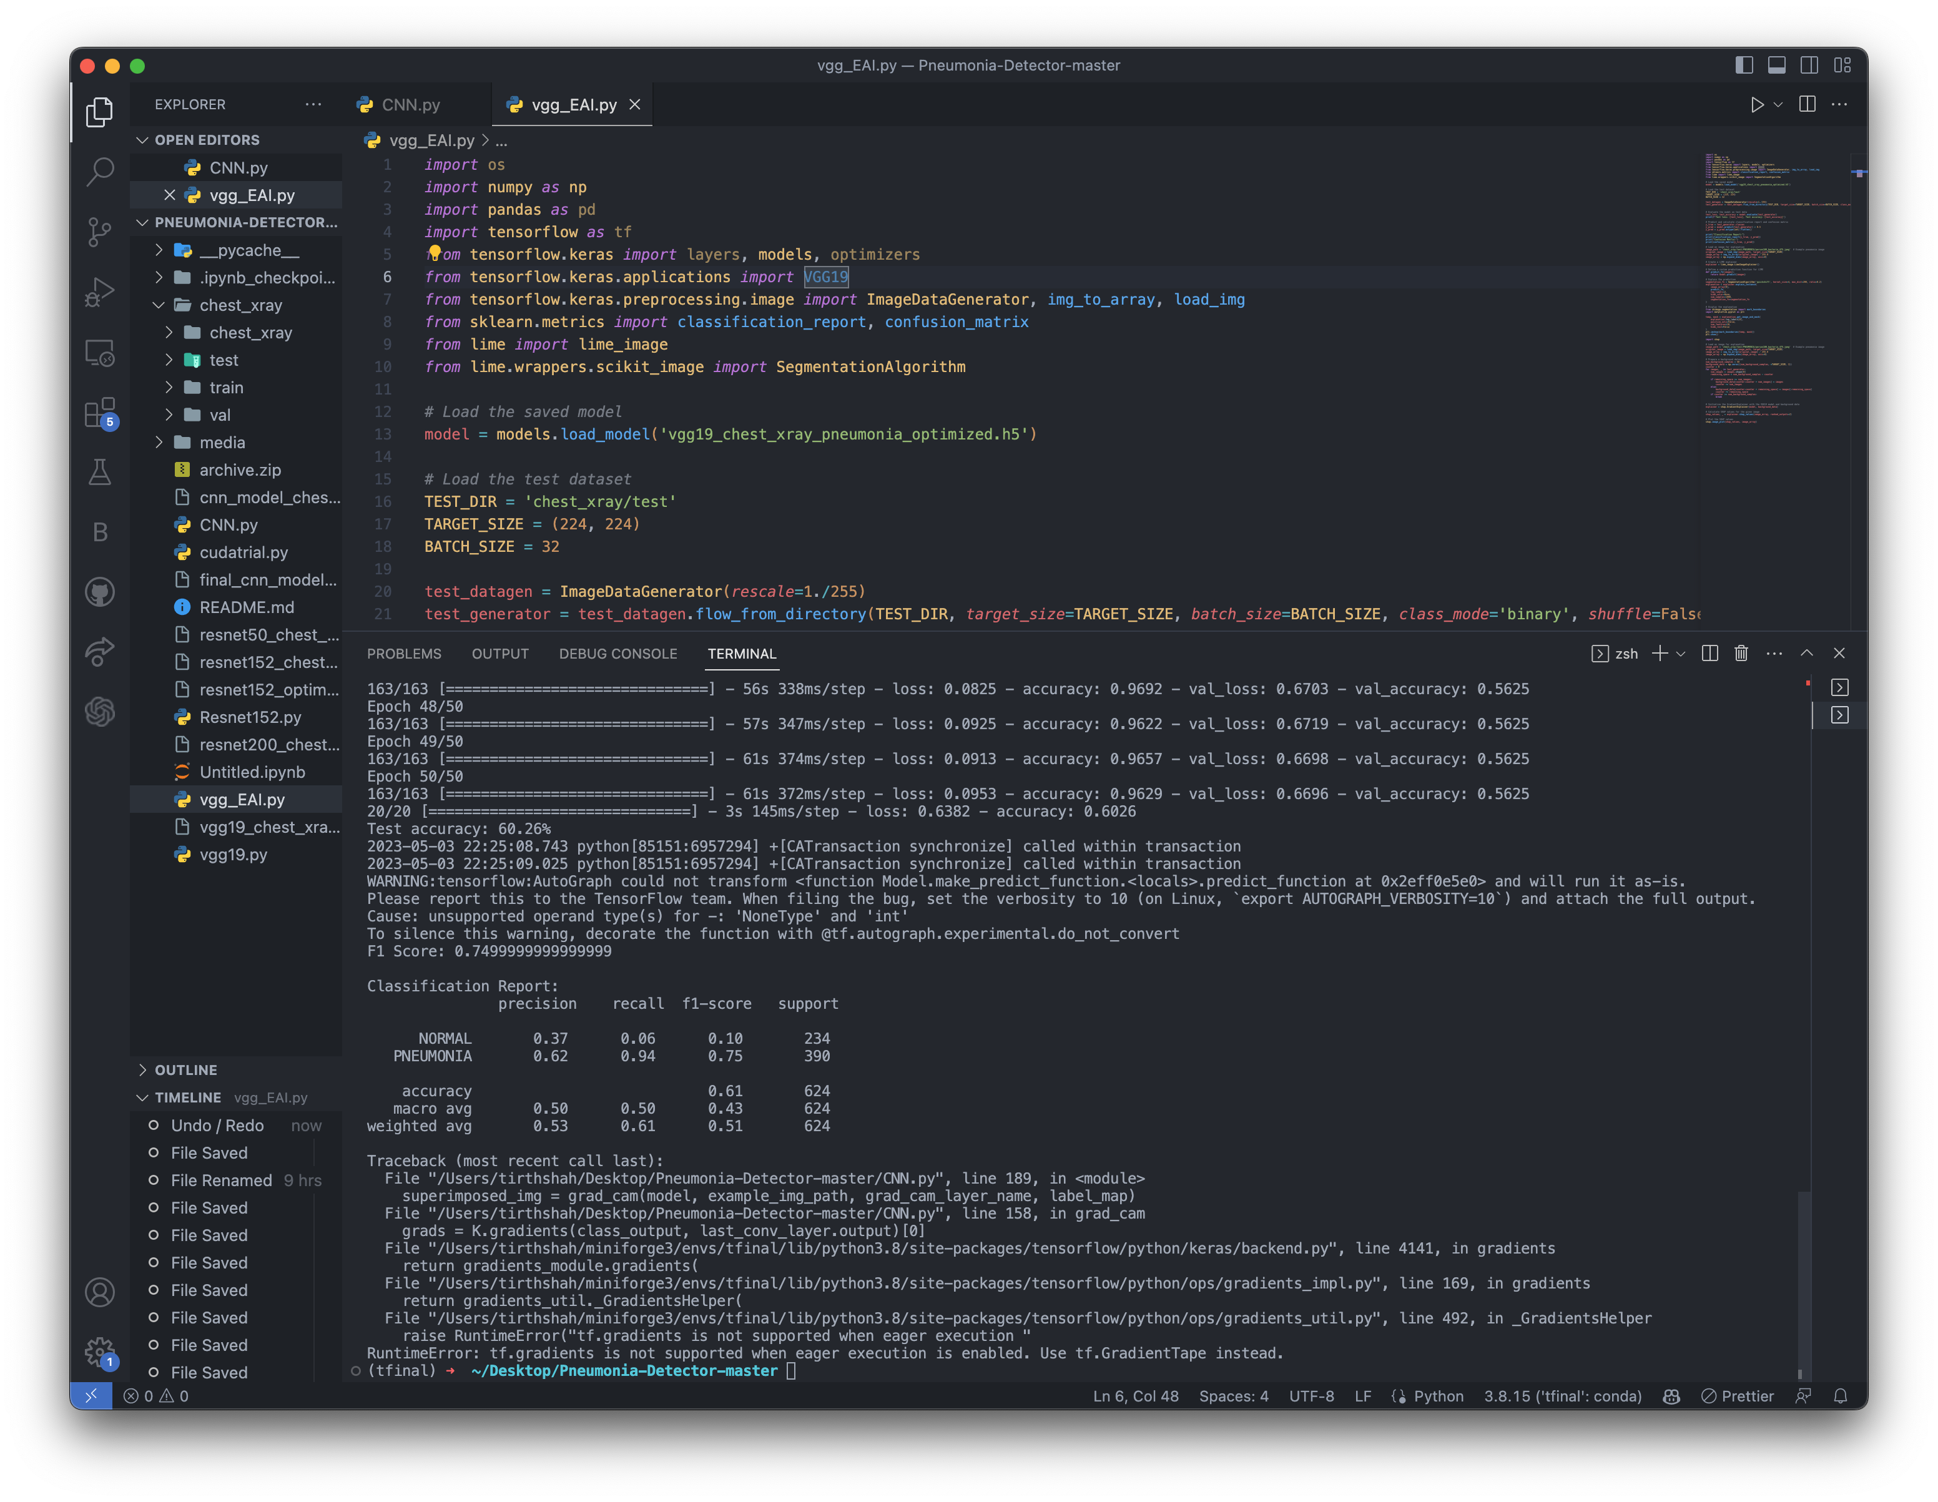
Results
VGG19
RESNET 152
RESNET 200
CNN

Slide 12
Conclusion
Based on the provided classification reports for the four models, the VGG19 model demonstrates the best overall performance in terms of accuracy (0.92), precision, recall, and f1-score.
While the CNN model has the lowest performance metrics, the ResNet152 and ResNet200 models exhibit moderate accuracy but lower precision and recall for the normal class compared to the VGG19 model.
In conclusion, the VGG19 model is the most suitable choice for pneumonia detection in this project, given its superior performance across all evaluation metrics.

Slide 13
Citation
Tilve, S. Nayak, S. Vernekar, D. Turi, P. R. Shetgaonkar and S. Aswale, "Pneumonia Detection Using Deep Learning Approaches," 2020 International Conference on Emerging Trends in Information Technology and Engineering (ic-ETITE), Vellore, India, 2020, p
L. Račić, T. Popović, S. čakić and S. Šandi, "Pneumonia Detection Using Deep Learning Based on Convolutional Neural Network," 2021 25th International Conference on Information Technology (IT), Zabljak, Montenegro, 2021, pp. 1-4, doi: 10.1109/IT51528.2021.
Habib, N., Hasan, M.M., Reza, M.M. et al. Ensemble of CheXNet and VGG-19 Feature Extractor with Random Forest Classifier for Pediatric Pneumonia Detection. SN COMPUT. SCI. 1, 359 (2020).

Slide 14
Thank you!

